Slide 2
I. Eccelsiology
Who is “Israel”?

Slide 3
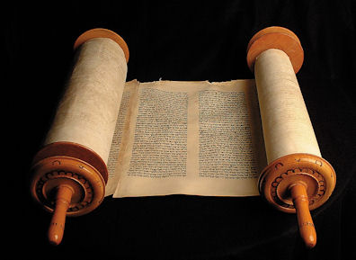
GOD
Gen 3-11
The Nations

Slide 4
GOD
Abraham
Isaac
Jacob/Israel
IIIIIIIIIIII
Gen 12-18
Gen 26, 28
The Nations

Slide 5
GOD
Covenant:
Israel
Exod 19-20
Lev 18-20
Deut 4-5
Deut 27-28
IIIIIIIIIIII
Torah
The Nations

Slide 6
SUPERCESSIONISM (“REPLACEMENT THEOLOGY”)
Church supersedes/replaces Israel
as God’s Covenant People
GOD
GOD
Covenant:
GOD
Covenant:
Jesus
Covenant:
Israel
IIIIIIIIIIII
Holy Spirit
church
IIIIIIIIIIII
Torah
IIIIIIIIIIII
Holy Spirit
The Nations
The Nations
The Nations

Slide 7
CONTINUALIST/DISPENSATIONAL THEOLOGY:
Church stands alongside Israel
as God’s 2nd Covenant People
GOD
GOD
Covenant:
GOD
Covenant:
Jesus
Covenant:
Israel
IIIIIIIIIIII
Holy Spirit
church
IIIIIIIIIIII
Torah
IIIIIIIIIIII
Holy Spirit
The Nations
The Nations
The Nations

Slide 8
FULFILLMENT THEOLOGY:
Corporate Solidarity - Jesus IS Israel.
Those “in” Him are God’s Elect Covenant People.
GOD
Isa 41-53
Matt 1-3
John 15
Gal 3
Eph 2-3
1Peter
Rev 1-3, 7
New
Covenant:
Deut 29-30
Jer 31
Ezek 36
Joel 2
“Seed”
“Servant”
MESSIAH
Holy Spirit
Israel is not “discarded” or “replaced”
…but “absorbed” & “fulfilled”
by/in the only true and faithful Israelite, Yeshua.
The Nations

Slide 9
Jesus as Israel:
John 15:1 - Jesus is the “true vine”
Matt. 2:15 – Jesus is “firstborn Son”
John 2:21 – Jesus is the “Temple”
Isaiah – Servant is also Israel
Notes:
”This is not a ‘transfer’ of ‘election’ from the community of ethnic Israel to someone else (e.g. a gentile ‘church’). It is the focus of election on Jesus precisely as Israel’s Messiah.”
-N.T. Wright, “Paul and the Faithfulness of God”

Slide 10
“In” Messiah = “in” Israel
Ephesians 2:11-19
…remember that formerly you who are Gentiles by birth and called "uncircumcised" by those who call themselves "the circumcision" (that done in the body by the hands of men)-- ¹² remember that at that time you were separate from Messiah, excluded from citizenship in Israel and foreigners to the covenants of the promise, without hope and without God in the world. ¹³ But now in Messiah Jesus you who once were far away have been brought near through the Messiah’s blood.

Slide 11
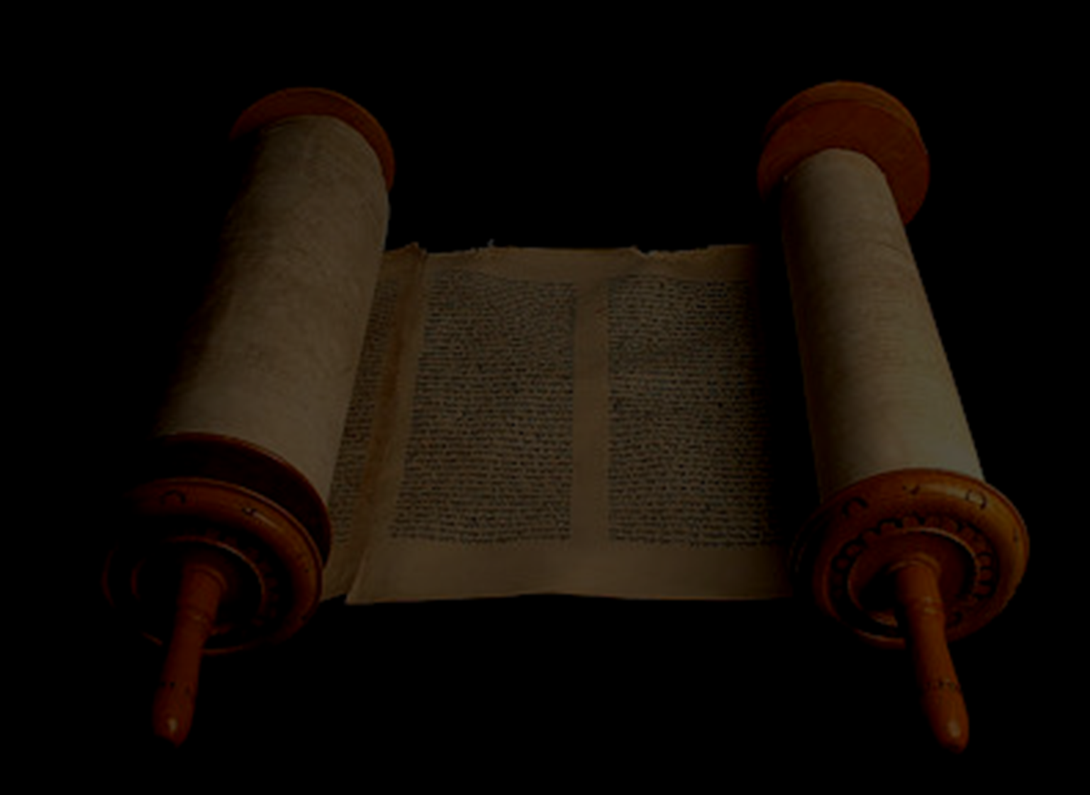
“In” Messiah = “in” Israel
¹⁴ For he himself is our peace, who has made the two one and has destroyed the barrier, the dividing wall of hostility, ¹⁵ by abolishing in his flesh the law with its commandments and regulations. His purpose was to create in himself one new man out of the two, thus making peace, ¹⁶ and in this one body to reconcile both of them to God through the cross, by which he put to death their hostility.

Slide 12
“In” Messiah = “in” Israel
¹⁷ He came and preached peace to you who were far away and peace to those who were near. ¹⁸ For through him we both have access to the Father by one Spirit. ¹⁹ Consequently, you are no longer foreigners and aliens, but fellow citizens with God's people and members of God's household…

Slide 13
“In” Messiah = “in” Israel
-Galatians 3:26-29
"You are all sons of God through faith in Messiah Jesus, ²⁷ for all of you who were baptized into Messiah have clothed yourselves with Messiah.
²⁸ There is neither Jew nor Greek, slave nor free, male nor female, for you are all one in Messiah Jesus. ²⁹ If you belong to Messiah then you are Abraham's seed, and heirs according to the promise."

Slide 14
FULFILLMENT THEOLOGY:
Corporate Solidarity - Jesus IS Israel.
Those “in” Him are God’s Elect Covenant People.
GOD
Isa 41-53
Matt 1-3
John 15
Gal 3
Eph 2-3
1Peter
Rev 1-3, 7
New
Covenant:
Deut 29-30
Jer 31
Ezek 36
Joel 2
“Seed”
“Servant”
MESSIAH
Holy Spirit
Israel is not “discarded” or “replaced”
…but “absorbed” & “fulfilled”
by/in the only true and faithful Israelite, Yeshua.
The Nations

Slide 15
“…[It] is not (as it is sometimes disparagingly called) ‘replacement theology’. It is rather ‘extension’, or ‘fulfillment’, theology. In the same way, the multinational community of believers in Jesus the Messiah is not a ‘new Israel’ (as if the old were simply discarded). It is rather God’s original Israel but now expanded and redefined in relation to Christ through the inclusion of the Gentiles—as God had promised ever since Abraham. …in Christ all are equal: no-one loses and everyone gains.”
-Christopher Wright “Old Testament Ethics and the People of God”

Slide 16
Paul sees Jesus…drawing Israel’s history to its strange but long-awaited resolution, fulfilling the promises made to Abraham, inheriting the nations of the world, winning the battle against all the powers of evil…This has nothing to do (as is sometimes suggested) with the replacement of the old Israel with a new one, and everything to do (as is less frequently noted) with Paul’s belief that Israel as a whole is summed up and redefined in and by Christos…
-N.T. Wright, “Paul and the Faithfulness of God”

Slide 17
II. Eschatology
What is God’s plan for “Israel”?

Slide 19
Do we interpret Biblical Prophecy & Apocalyptic LITERALLY… or LITERARILLY?

Slide 20
Josh. 21 & 1Kgs 8 All the promises to Israel have come to pass?
Malachi 4 “Elijah to come” John the Baptist? (Matt. 11:14, Mark 9:13)
Joel 2’s “Day of YHWH” Fulfilled at Pentecost? Still future?
Ezekiel 40-48 3rd Temple? Millennial? Sacrifices?

Slide 21
What about all
the land promises?
"All the land that you see I will give to you and your offspring (‘seed’) forever" -Genesis 13:15

Slide 22
Stewardship of YHWH’s land contingent on faithfulness to YHWH’s Covenant
"The land must not be sold permanently, because the land is mine and you are but aliens and my tenants."
-Leviticus 25:23
"Keep all my decrees and laws and follow them, so that the land where I am bringing you to live may not vomit you out."
-Leviticus 20:22

Slide 23
What about “forever/everlasting”?
"All the land that you see I will give to you and your offspring (‘seed’) forever" -Genesis 13:15
Notes:
"Through your own fault you will lose the inheritance I gave you. I will enslave you to your enemies in a land you do not know, for you have kindled my anger, and it will burn forever."
-Jeremiah 17:4

Slide 24
"...My covenant in your flesh is to be an everlasting covenant."
-Genesis 17:13
"For in Messiah Jesus neither circumcision nor uncircumcision has any value. The only thing that counts is faith expressing itself through love. ...Neither circumcision nor uncircumcision means anything; what counts is a new creation.“ -Galatians 5:6; 6:15

Slide 25
Land Restoration Promises:
Historical?
Eschatological?
Both??
i.e. Isaiah 65-66 “New Heavens & New Earth”
Notes:
Israel lost the land and were exiled…but promise of restoration from exile to the land and transformation of the land itself were given by the Prophets.
“As Israel looked to the future completion of God’s redemptive purpose, they did so in terms drawn from their experience of the past and present. Thus as they could not conceive of the new covenant without law, even though it would be law that transcended the reach of any legislator, for it would be written on the hearts of God’s people (Jer. 31:33), so they could not conceive of God’s future multinational redeemed people without land, even though it would be land that transcended the imagination of any geographer or even zoologist! The transformation of nature in passages such as Isaiah 2:2; 11:6-9; 35:1-10; Jeremiah 31:1-14 and Hosea 2:18-23 is clearly not intended literally. Yet neither should it be simply spiritualized, or taken as merely metaphorical. God’s redemptive purpose for his creation may be beyond our imagination, but not beyond the eye of faith.” -Christopher Wright (“Old Testament Ethics and the People of God”)

Slide 26
“All Israel” will
be saved??
Romans 9-11
Notes:
Paul establishes up front the distinction between “Israel” and “Israel”…we can’t simply say ‘since Paul uses ‘Israel’ to refer to Jews most of the time, it follows that in ch.11 he’s only referring to Jews coming to faith’. This doesn’t do justice to the rhetorical flow of Paul’s entire argument in Rom.9-11 or his theology as a whole!
it is not at all clear what exactly Paul has in mind, and he probably intended it that way. Eschatology, even messianically revised eschatology, is all about peering ahead into the darkness, believing in certain clear fixed points but not being able to say what exactly will happen next. He is not going to make any predictions about whether God will save a myriad of his presently unbelieving fellow Israelites, or somewhat less; only (a) that he will save ‘some’, in other words considerably more than at present, (b) that this will count as a ‘fullness’, plērōma, and (c) that this will be the full extension of the small but growing ‘remnant’ of which he, Paul, is himself a part.
Wright, N. T. (2013-11-01). Paul and the Faithfulness of God: Two Book Set (Christian Origins and the Question of God) (Kindle Locations 33001-33006). Fortress Press. Kindle Edition.

Slide 27
^{9:6} It is not as though the word of God has fallen away. For not all the ones from Israel are themselves Israel, ⁷ nor are all the children the seed of Abraham… ⁸That is, not the children of the flesh who are the children of God; rather, the children of promise are reckoned as seed.

Slide 28
^{10:9} because if you confess with your mouth that Jesus is Lord and believe in your heart that God raised him from the dead, you will be saved. ¹⁰ For by the heart it is believed unto righteousness and by the mouth it is confessed unto salvation. ¹¹ For Scripture says, "Everyone believing upon him will not be put to shame." ¹² For there is no distinction—Jew or Greek—for he [is] Lord of all, richly blessing all who are calling on him. ¹³ For whoever may call upon the name of the Lord will be saved.
Notes:
The center and focal point of the entire passage.

Slide 29
^{11:1} I say then, hasn’t God rejected his people?
May it never be! For I also am an Israelite, from the seed of Abraham, the tribe of Benjamin. ² God has not rejected his people whom he foreknew!
…⁵ So then also at the present time there is a remnant according to the choice grace.
…⁷ What then? Israel did not obtain what it was seeking, but the elect obtained it. And the rest were hardened…
…¹¹ ‘I say then, did they not stumble in order that they might completely fall?’ May it never be!
Notes:
So then…are ethnic Jews permanently cut off from the people of God through their hardness of heart??
No! First of all, Paul & other messianic Jews are the remnant.
Paul is not saying that presently unbelieving Jews are, or will be, necessarily saved, any more than he was saying in 1 Corinthians that an unbelieving spouse, however much ‘sanctified’ by the believing one, was automatically saved. If he had believed that about his fellow (but unbelieving) Jews, he could have saved himself a lot of heartache…His point, here and throughout the section, is that they are not automatically not saved. That is the rhetorical thrust of the entire chapter, and in a measure of the whole of chapters 9— 11.
Wright, N. T. (2013-11-01). Paul and the Faithfulness of God: Two Book Set (Christian Origins and the Question of God) (Kindle Locations 33085-33086). Fortress Press. Kindle Edition.

Slide 30
²³ But those—if they do not continue in unbelief—will be grafted in, for God is able to graft them in again. ²⁴ For if you were cut off from what is by nature a wild olive tree, and contrary to nature, were grafted into a cultivated olive tree, how much more will these natural branches be grafted back into their own olive tree?! ²⁵ For I do not want you to be ignorant of this mystery, brothers and sisters, so that you may not be wise in your own sight.
A hardness in part has happened to Israel until [the time in] which the fullness of the Gentiles may come in. ²⁶ And (houtos) all Israel will be saved…
Notes:
The Olive Tree “mystery” – Jew and Gentile together as one body (cf. Eph.2-3, Gal.3, Rev.7)
As in Galatians, the gentile Messiah-believers have come to belong to the tree which is Abraham’s family. This would make no sense unless Paul, here as elsewhere, is narrating the gentile believers into the story of Israel. They are part of that single family: neither the beginning of a new family in which Jews are not welcome (as Paul is afraid some Roman Messiah-followers may think); nor even a brand new family into which a few of Abraham’s old family happen to have been included; but the same family which began with Abraham.
He is facing, more or less, the opposite problem to the one he had faced in Galatia. There, ex-pagan Messiah-believers were being pushed towards getting circumcised and becoming ‘children of Abraham according to the flesh’. Here, Paul has a shrewd suspicion that in Rome he will find ex-pagan Messiah-believers whose local culture is pushing them towards a view of Judaism, and of the unbelieving Jews who embody it, as beyond the pale, possessing as it were a tangential relationship to Jesus but having turned aside from him, and leaving the way clear for this new movement, apart from its earliest members, to consist of gentiles only. 616 That was, more or less, what Marcion taught in Rome, within a hundred years of this letter. It was a popular message. Paul did not need special prophetic gifts to see the danger just a little way down the road.
Wright, N. T. (2013-11-01). Paul and the Faithfulness of God: Two Book Set (Christian Origins and the Question of God) (Kindle Locations 33259-33265). Fortress Press. Kindle Edition.

Slide 31
καὶ οὕτως πᾶς Ἰσραὴλ σωθήσεται
“And so/then all Israel will be saved”
i.e. later after the fullness of Gentiles have come in, a mass turning to God by ethnic Jews; “mystery” is how mass conversion will happen; at Jesus’ return or before?
_____
“And thus/in this way ‘all Israel’ will be saved”
i.e. by being grafted back in alongside believing Jews & Gentiles as “all Israel”; “mystery” (Eph.) is the Olive Tree—Jew and Gentile together as ‘Israel’; the “Israel of God” (Gal.)
Notes:
It all comes down to how we translate ONE SINGLE PREPOSITION!!
“That is how” …Every element in verse 25 is thus simply a summary of what has gone before. -Wright
The only question is whether he sees this as the adding of the unbelieving majority to the believing minority of Jews, which then amounts to “all Israel.” Or is he talking about adding the unbelieving majority of Jews to the whole people of God and so the whole people are brought up to “fullness,” both Jew and Gentile united in Christ. -Ben Witherington, III, (Paul’s Letter to the Romans: A Socio-Rhetorical Commentary)
To repeat: Paul is not saying that all those presently ‘hardened’ are bound to remain in that condition. On the contrary. That is the position he fears the gentile Christians in Rome may adopt, and he is arguing against it, all the way from 11.11 to 11.32. Indeed, it is partly in order to argue against that position that he has constructed this seriously dense and densely serious section of the letter. Presently hardened Jews can at any time, he insists, be ‘made jealous’, and can thereby be brought to Messiah-faith and so to salvation. But we must not, in our eagerness to agree with him on this subject, overaccept the point and over-exegete the passage. The ‘until’ clause (‘ until the fullness of the nations comes in’) does indeed provide a temporal marker, but it is not a marker which of itself can tell us what happens to the ‘hardened’ part of Israel once that time is reached. The majority view among recent exegetes has been to read the ‘until’ as indicating the time after which the ‘hardening’ will be lifted, and all ‘the rest’, suddenly unhardened, will be saved (with or without faith). 663 But Paul does not say this, and we must not without warrant lurch after such an understanding.
Paul gives no indication that he is talking about a further event, but rather gives every indication that this process in 11.25 – the hardening of Israel apo merous, and the use of the time thus created for the fullness of the gentiles to come in – is the means by which God is saving ‘all Israel’. The distinction between reading houtōs as an indication of time and an indication of manner effects a serious shift. If we read it as temporal, it opens up a forward perspective in the text: ‘and then, something new will happen, namely the salvation of “all Israel”, as scripture says …’. But if we read it as an indication of manner, it looks back: ‘and that, the entire sequence of 11.11– 24, summed up in 11.25, is how “all Israel” will be saved’. But this brings us to the all-important phrase itself.
Clearly Paul has not settled on a single designation for the Messiah-people. But, equally clearly, he constantly refers to that people in ways which indicate what his explicit argument in Romans 2— 4, in 2 Corinthians 3, in Galatians as a whole and in Philippians 3 all make clear: that in Israel’s Messiah, Jesus, the one God has fulfilled the ancient Israelite hope, expressed by Torah, prophets and Psalms alike, by bringing the nations of the earth to belong to Abraham’s people. Paul is acutely aware of the many painful paradoxes that go with this belief, but he will not draw back from it.
Wright, N. T. (2013-11-01). Paul and the Faithfulness of God: Two Book Set (Christian Origins and the Question of God) (Kindle Locations 33762-33766). Fortress Press. Kindle Edition.
Ross Wagner: “For Paul, ‘Israel’ will be a complete entity only when ‘the fullness of the gentiles’ comes in and ‘the Redeemer’ comes from Zion to take away ‘Jacob’s’ sins.”
“A hardening has come upon part of ‘Israel’, until the fullness of the gentiles has ‘come in’ to that same ‘Israel’, causing a much greater number of those presently ‘hardened’ to become ‘jealous’ and to swell the present small ‘remnant’ to a ‘fullness’ out of all proportion to its present diminution; and that is the means by which, in the traditional phrase, ‘All Israel shall be saved.’”
The ‘all’ in ‘all Israel’ here is in my judgment best understood as a typically Pauline (and characteristically cryptic) note of redefinition, in line with the other such points elsewhere, not least Galatians 6.16. There is every possibility, therefore, that pas Israēl in Romans 11.26 is just such another polemical redefinition, picking up the phrase which may have already been current: ‘All Israel has a share in the age to come’. Just as the rabbis redefined that phrase so that it excluded Sadducees, and other Jews deemed to be beyond the pale, 687 so Paul has redefined it to include (1) Messiah-believing Jews – himself, all others already in that category and, he hopes, a much larger number who come to be ‘jealous’ and so to believe, 688 and (2) Messiah-believing gentiles (‘ to the Jew first, and also equally to the Greek’). But it excludes, as the rabbis’ own ‘all Israel’ excluded those who were deemed outside, those Jews who, despite being given a space of time by God’s patience and kindness, have stumbled over the stumbling stone and have not picked themselves up, have not become ‘jealous’ in the way Deuteronomy 32 described, have not been provoked by Paul’s own gentile apostolate, have not come to believe and confess in the way Deuteronomy 30 indicated, have not ‘submitted to God’s righteousness’ (10.3), have not availed themselves of God’s circumcision of the heart, have not joined in the renewal of the covenant and have not grasped at the divine fulfilment of the Abrahamic promises. To be sure, Paul locates this multiple failure ultimately in the inscrutable purposes of Israel’s God. But he also lays all these charges at the door of his contemporaries. This is not what most exegetes in the modern western tradition have wanted to hear. But it is what Paul wanted to say.
The point of it all – the thrust of this passage within the actual argument of Romans 11, as opposed to any grander scheme of soteriology or salvation history – is once again to insist, not upon a grand, large-scale last-minute conversion of all Jews (which would not have been relevant to the theme Paul is here stressing; if that was what was intended, the gentile Christians in Rome could have shrugged their shoulders and waited for God to do that in his own time) but upon what we might call the saveability of Jews within the continuing purposes of God. And this in turn is because Paul wants to be sure that the gentile Christians in Rome have really understood grace: all who are saved are saved by God’s grace, and that means that ethnic origins, whether Jewish or gentile, generate no claim in themselves. That is the point of verses 20 and 23– 4 in particular: gentile Christians ‘stand fast’, not because they are gentiles (the temptation which Paul is warding off) but because they are Messiah-faith people. Likewise, when they are faced with the cultural pressure to dismiss the Jews as hopelessly cut off from God for ever, they must continually remind themselves that, following their ‘casting away’, such unbelieving Jews are now just as open to grace, just as able to be ‘received back’, as were the gentiles themselves – indeed, more so, since the ‘olive tree’ from which they have been cut out is still ‘their own olive tree’ (verse 24).
Wright, N. T. (2013-11-01). Paul and the Faithfulness of God: Two Book Set (Christian Origins and the Question of God) (Kindle Locations 33957-33967). Fortress Press. Kindle Edition.

Slide 32
The Prophets envisioned
an “Israel” that
would one day
include Gentiles

Slide 33
“…there would be those of the nations who would not merely be joined to Israel, but would come to be identified as Israel, with the same names, privileges and responsibilities before God (Ps. 47:9; Is. 19:19-25; 56:2-8; 66:19-21; Amos 9:11-12; Zech. 2:10-11). …[in Isa 19:24-25] the identity of Israel will be merged with that of Egypt and Assyria, such that the Abrahamic promise is not only fulfilled in them but through them.”
-Christopher Wright “Old Testament Ethics and the People of God”
Notes:
“The OT is our story. Joshua is not simply my hero. He is my forefather. The Patriarchs are our ancestors. Israel’s victory in the OT is our victory as a community of faith today… I am not saying that the church has replaced Israel. Instead, I believe that we joined Israel. We became part of Israel. I believe that Jesus is the true Israelite… and since we are in Christ today, then we are and have always been in Israel. At a certain time in history, we were not part of God’s household… But the implications of Ephesians 2 and Romans 11 are that now we are God’s household, and since we are God’s household…we claim the history of salvation that started in the OT and found its culmination in the death and resurrection event as our history. We share in the nourishing root of the olive tree...
[The State of] Modern Israel not only robbed us of our land and freedom, but it also robbed us of our Scripture and spiritual heritage as Palestinian Christians.”
-Dr. Munther Isaac in The Land Cries Out: Theology of the Land in the Israeli-Palestinian Context.

Slide 34
III. Ethics
Should Christians “stand with” the modern state of Israel?

Slide 35
State of Israel & Zionism =/= Jewish People & Judaism
Throughout history, many Jews in Israel and worldwide have rejected political/nationalistic Zionism and SEVERELY criticized Israel’s treatment of the Palestinians.

Slide 36
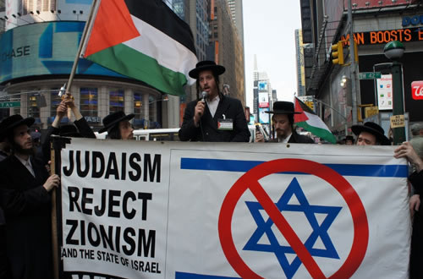
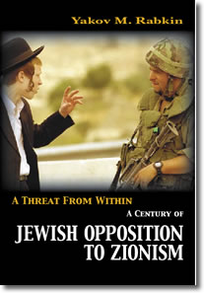
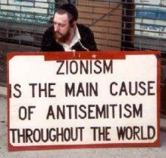
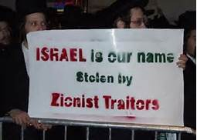

Slide 37
Opposition to Israeli Policy =/= Anti-Semitism

Slide 38
“Whoever says that this government is committing crimes against humanity is not an anti-Semite but an honest and humane person.”
-Shulamit Aloni
Member of the Knesset 1976-1996

Slide 39
Trauma & Victimhood
“We create narratives out of our pain that are self-justifying.”
-Dan Juster Christ at the Checkpoint 2014
Shoah (Holocaust)
Nakba (Catastrophe)

Slide 40
Trauma & Victimhood
Have understandably led to:
* Defensiveness toward critics * Contradictory narratives * Selective historiography * “invented people” charges * Fear-based/emotional rhetoric

Slide 46
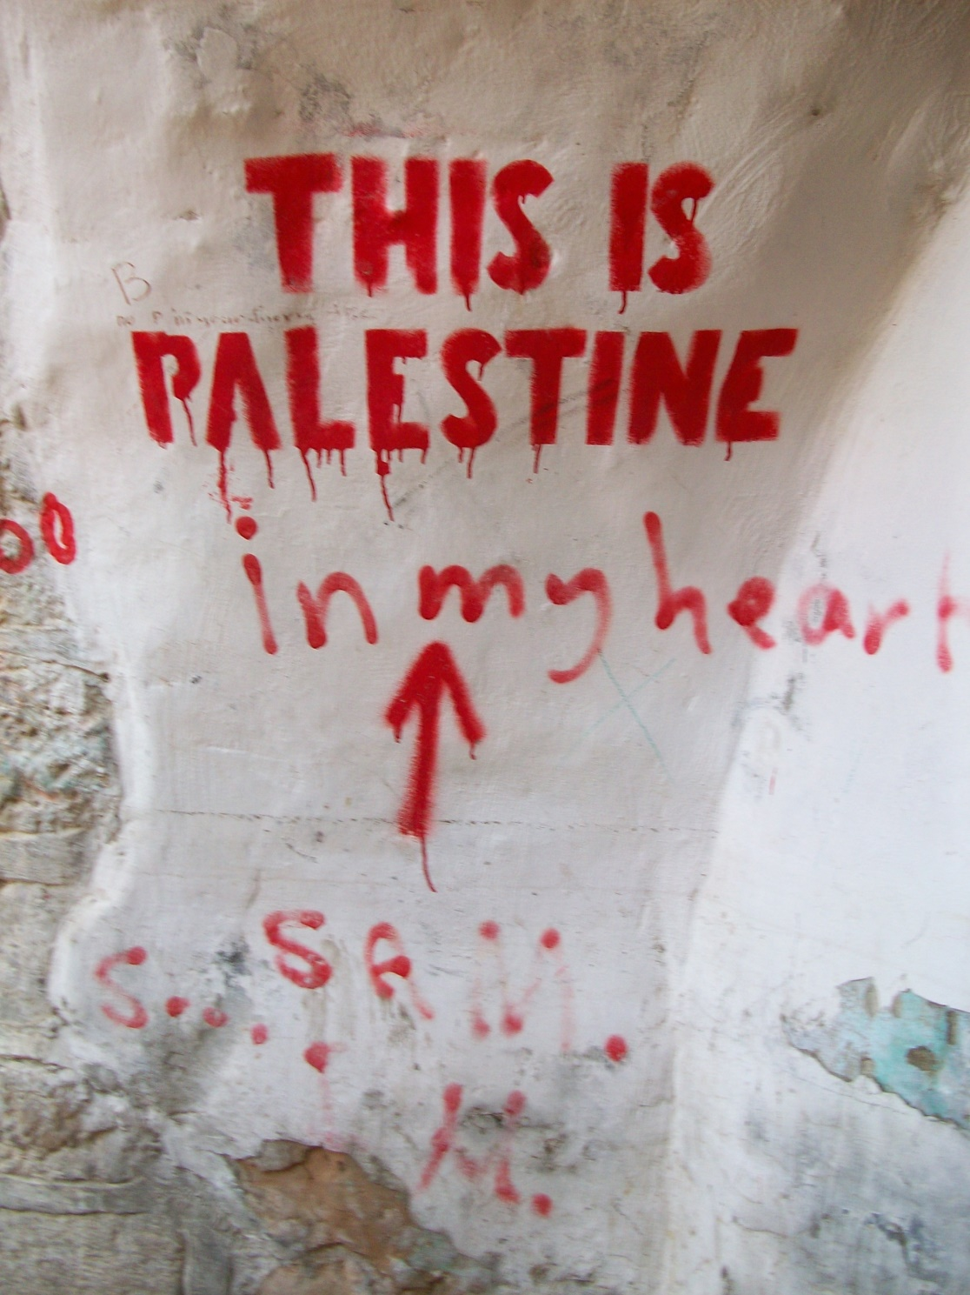
Notes:
“…both Arabs and Jews were able, by cherrypicking, to buttress their positions by selectively quoting this or that passage. And they continue to do so, sometimes to my chagrin. But the task of the historian is to get the story right, not to pander to this or that political inclination or to hide this or that fact or quote because it may serve political purposes with which he is in disagreement. This is something basic that Karsh (and Ilan Pappe, from the other side of the barricades)…simply do not understand.”
-Prof. Benny Morris http://www.americanthinker.com/2011/07/my_response_to_efraim_karsh.html

Slide 47
“There is no conflict between Jewish and Palestinian nationalism because the Jewish nation is not in Palestine and the Palestinians are not a nation.”
-David Ben Gurion, 1936
-Nur Masalha Expulsion of the Palestinians: The Concept of "Transfer" in Zionist Political Thought, 1882-1948
Notes:
“I do not admit that the dog in the manger has the final right to the manger, even though he may have lain there for a very long time. I do not admit that right. I do not admit, for instance, that a great wrong has been done to the Red Indians of America, or the black people of Australia. I do not admit that a wrong has been done to those people by the fact that a stronger race, a higher grade race, or, at any rate, a more worldly-wise race, to put it that way, has come in and taken their place.”
-Winston Churchill, 1937
Ben White Palestinians in Israel: Segregation, Discrimination and Democracy

Slide 48
Trauma & Victimhood

Slide 49
Avigail Abarbanel (Israeli-born psychotherapist/IDF veteran):
“From a very young age, about 6 or 7 years old my generation was exposed to gruesome images of the Holocaust, piles of dead emaciated bodies, the mountains of shoes, the gates of Auschwitz, hungry and filthy children and adult prisoners in stripy pajamas peering desperately through barbed wire. We were taught Holocaust stories, real and fictional, about the life of children like us in the Ghettos under the Nazis: the ever present hunger, the crowded conditions, the daily struggle to survive, the uncertainty, heroic children risking their lives to smuggle food into the ghettos…

Slide 50
…and the constant terror of cold-hearted SS soldiers, their guns and their dogs. The messages were crystal clear: ‘This could be you because you are Jewish. The only reason it isn’t, is not because they won’t try to do it to you—they almost certainly will do this again—but because you are here in Israel. The Holocaust victims were weak Jews but you are an Israeli Jew, and you must grow up to be strong. Israel is the only protection you have against being like one of these children in the stories or in the photos. You must help make Israel strong and do everything you can to make sure it survives, so that you don’t end up like these Holocaust children.

Slide 51
Abarbenal: “Shoah-centric” view
We are Jews and therefore everyone hates us; everyone hates us because we are Jews. This hatred cannot be changed. Hatred of Jews is in the blood of every gentile and is passed on genetically. It’s like a mental illness that can’t go away.
Even those who don’t exactly hate us were not prepared to stick up for us when we were in trouble, therefore non-Jews can never be trusted. There are ‘good gentiles’ and ‘bad gentiles’ but we can’t really trust even the good ones.

Slide 52
This is our fate from the beginning of our existence. The Jewish people have been despised and persecuted from their beginnings. There is a continuous history leading up from biblical times to the present day. It’s never changed. Hitler and Pharaoh of the Exodus story are the same.
The Holocaust is the ultimate proof that Jews cannot be safe among non-Jews.
This must never happen to us again. It happened to us because we were weak therefore we must become very powerful and never let anyone push us around.

Slide 53
Israel is the only safe haven for Jews and must remain under Jewish sovereignty. It must always guarantee special rights for Jews, like the Right of Return, so that no Jew anywhere will ever find him or herself in the same situation as the Jews who were victims of pogroms and of the Holocaust.
We will never be safe until all foreigners and Arabs in particular are pushed away from our borders. We can only be safe among our own people.

Slide 54
We have a right to hurt others because we have been hurt—the principle of ‘destructive entitlement’ (a term from family therapy) is at the heart of Jewish-Israeli culture.
Another Holocaust is imminent. Jews from around the world must have a place to run to when it happens. Israel needs to have enough land and resources to take in 12 million Jews.
Jews have a special relationship with God. Jews are more ethical and moral than all other people. By extension Israel as a Jewish state is a more moral and noble country than other countries. It is ‘the only democracy in the Middle East’.

Slide 55
Israeli wars are different to other people’s wars. Our wars are just and are all ‘wars of no-choice.
Our occupation is different to other occupations. We treat the Palestinians better than occupied people in other places. We cannot possibly be compared with other bad countries who do bad things.
Our colonization of Palestinian lands is different too. First, it’s our land anyway, and second, as Jews we didn’t have a choice. What did you want us to do—die in the Diaspora?
Our suffering is greater and more special than the suffering of anyone else.

Slide 56
Even the hatred of Jews is not like other types of racism. It’s different and special. The Holocaust is proof of that. The Holocaust is unlike any other genocide in human history.
Criticism of Israel is not like criticism of other countries. It is anti-Semitism in modern disguise.
By extension any Jew who criticizes Israel is aiding and abetting not only the enemies of Israel but the enemies of the Jews in general, and are therefore traitors. To be a traitor you must be mentally defective in some way. Healthy people are loyal to their group no matter what.

Slide 57
Our survival is more important than the survival of anyone else. We have more right to exist than they do. Our love for our children and our families is superior to that of others.
Israel’s strategic enemies hate Israel because it is a Jewish state. Their hatred has nothing to do with anything Israel might have done.
Opposition to Israel in the region has nothing to do with sympathy towards the Palestinians and everything to do with anti-Semitism. Arabs and Muslims in general hate Jews.

Slide 59
Fear-based,
nationalistic
worldview

Slide 60
Notes:
[Arabs are] “beasts of the desert, not a legitimate people…The Arabs are not a nation but a mole that grew in the wilderness of the eternal desert. They are nothing but murderers.”
-Avraham Stern, 1940
-Nur Masalha Expulsion of the Palestinians: The Concept of "Transfer" in Zionist Political Thought, 1882-1948

Slide 61
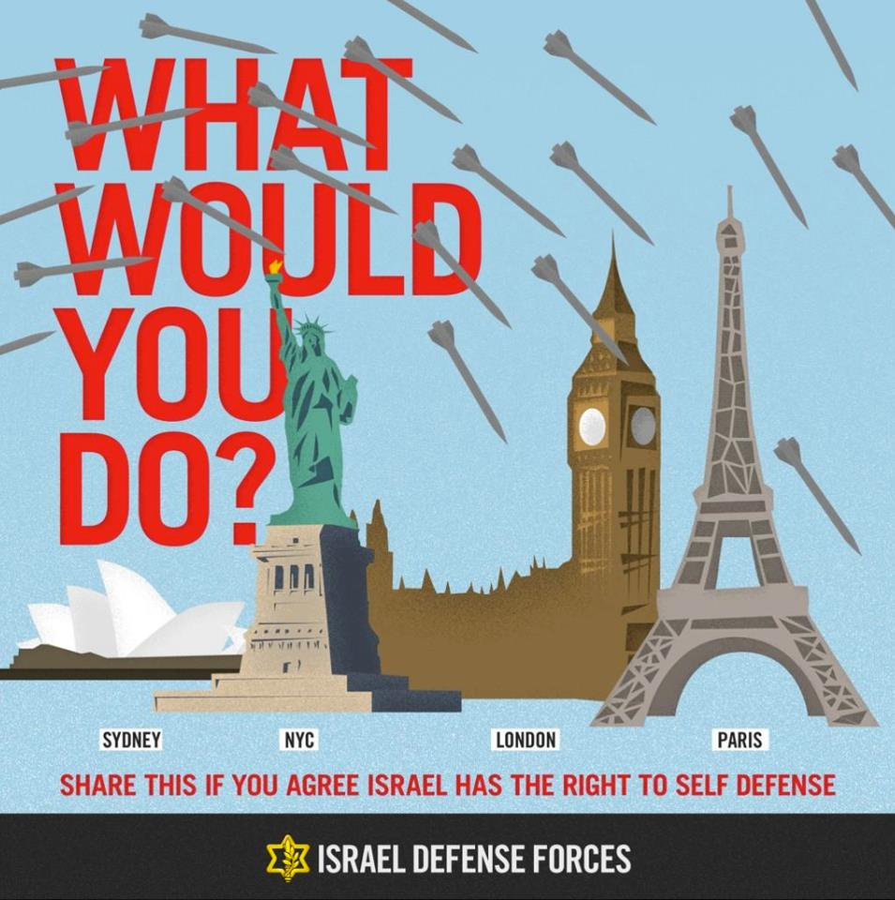

Slide 63
1948: Isreal’s National Birth
* Haven for persecuted Jews
* Freedom & Self-rule
* National homeland
* A Jewish Democracy
Notes:
it was OK to let go of the comfort of holding onto what I “knew” to be true. It opened the door to a discussion most Israelis are fiercely protective about—which is, what did the Zionist forces really do in 1948? Once I had taken a few steps into that unknown, I found confidence, and to my surprise I found that there was something even more secure to rely on than the myths of heroism and redemption I’d heard during my childhood. Many if not all of these myths were created and perpetuated by the new Jewish state, which wanted to substantiate the David versus Goliath image and painted my people as heroes who rose from the ashes to reclaim their historic homeland. For me, the only thing stronger than that myth was trust—the trust that was already in place between members of the dialogue group. Without that there could have been no progress. The group was not about accusing but listening and telling personal stories, and that was what allowed me, for the first time in my life, to learn that the Palestinians had a narrative of their own and that it was different from the narrative I had been taught. In fact, it was 180 degrees different.
[Peled, Kindle Locations 2296-2304]

Slide 64
1948: Al Nakba
“The Catastrophe”
* Planned Population Transfer
* Forced Expulsion (“Ethnic Cleansing”)
* Annexation of Territory
* The “Demographic Problem”
Notes:
Jabotinsky endorsed the terror campaign launched in the late 1930s by the Irgun, a campaign that involved such actions as placing bomb-loaded vegetable barrows in crowded Arab markets in Haifa and Jerusalem and firing indiscriminately on Arab civilian houses.
Irgun’s bombing attacks of the late 1930s and 1948 were aimed at Palestinian civilians
Lehi specialized in political assassinations.
Between the Haganah’s 20 May 1947 blowing up of an Arab cafe in Fajjah and the Stern Gang’s blowing up of the Cairo-Haifa passenger train (forty Arab civilians killed, sixty injured) in March 1948, more than 90 attacks on Arab villages or civilian targets took place.
Most of these attacks did not involve an exchange of fire; they included such terrorist acts as burning cinemas, setting off explosives in market places, spraying bullets into crowds gathered at cafes or in the streets, dynamiting houses with people in them, and so on.
- Nur Masalha, Expulsion of the Palestinians: The Concept of "Transfer" in Zionist Political Thought, 1882-1948
Kafr Qasim massacre in 1956 when close to 50 villagers were murdered by soldiers enforcing a curfew. The Eight soldiers who received jail terms had their sentences commuted, and were all out 4 years later. The commanding officer was fined an agora, ‘Israel’s smallest coin’. (White, p. 81).

Slide 65
“When we occupy the land…we shall try to spirit the penniless population across the border by procuring employment for it in the transit countries, while denying it any employment in our own country. The property owners will come over to our side. Both the process of expropriation and the removal of the poor must be carried out discreetly and circumspectly. Let the owners of immovable property believe that they are cheating us, selling us something far more than they are worth. But we are not going to sell them anything back.”
-Theodore Herzl, 1895
Notes:
European Colonialism/Imperialism [We] must be prepared either to drive out by the sword the [Arab] tribes in possession as our forefathers did or to grapple with the problem of a large alien population, mostly Mohammedan and accustomed for centuries to despise us.
-Israel Zangwill, 1905
“The demand that the Arabs should move out and evacuate the place for us, because they have sufficient place to move to and we have no place....is very just and very moral—but in this situation now, we would not be able to present it to the political world as a serious claim, and against our will we have to come to terms with partition.”
-Shlomo Lavi, prominent kibbutz leader

Slide 66
“If there are other inhabitants there, they must be transferred to some other place. We must take over the land. We have a greater and nobler ideal than preserving several hundred thousands of Arab fellahin.
This is the land problem....Now the Arabs do not want us because we want to be the rulers. I will fight for this. I will make sure that we will be the landlords of this land...because this country belongs to us and not to them.”
-Menahem Ussishkin, 1930
Chairman, Jewish National Fund
Notes:
“I had to…defend the fact that I would not accept Arabs in my trade union…to prevent Arab workers from getting jobs there....To pour kerosene on Arab tomatoes; to attack Jewish housewives in the markets and smash the Arab eggs they had bought; to praise to the skies the Kereen Kayemet [Jewish National Fund] that sent Hankin to Beirut to buy land from absentee effendi [landlords] and to throw the fellahin [peasants] off the land—to buy dozens of dunams—from an Arab is permitted, but to sell, God forbid, one Jewish dunam to an Arab is prohibited.”
-David Hacohen, Mapai leader

Slide 67
“Amongst ourselves it must be clear that there is no room for both peoples in this country…After the Arabs are transferred, the country will be wide open for us…When the war is over, and the English have emerged victorious and when the judging nations sit on the throne of law, our people should bring their petitions and claims before them; and the only solution is the Land of Israel, or at least the Western Land of Israel [i.e., Palestine], without Arabs. There is no room for compromise on this point. The only way is to transfer the Arabs from here to neighboring countries, all of them, except perhaps Bethlehem, Nazareth, and Old Jerusalem… Not a single village or a single tribe must be left…There is no other solution. We have clashing interests with the Arabs…and these interests will go and clash increasingly...

Slide 68
only population transfer and evacuating this country so it would become exclusively for us is the solution…The complete evacuation of the country from its other inhabitants and handing it over to the Jewish people is the answer…only through population transfer will redemption come... There is no room for us with our neighbours... They are too many and too much rooted...the only way is to cut and eradicate them from the roots. This is the aim, the redemption, and the dream… From now on we must work out a secret plan based on the removal of the Arabs from here and… inculcate it into American political circles...today we have no other alternative...we will not live here with the Arabs.”
-Yosef Weitz’ diary (unedited manuscript)
Central Zionist Archives, Jerusalem
Notes:
“...transfer of Arabs out of the country in my eyes is one of the most just, moral and correct things that can be done. I have thought this for many years.”
Shlomo Lavi
[There is nothing] “more moral, from the viewpoint of universal human ethics, than the emptying of the Jewish state of the Arabs and their transfer elsewhere....This requires [the use of] force.”
-Avraham Katznelson

Slide 69
“We must expel Arabs and take their places... and, if we have to use force—not to dispossess the Arabs of the Negev and Transjordan, but to guarantee our own right to settle in those places—then we have force at our disposal…It is very possible that the Arabs of the neighboring countries will come to their aid against us. But our strength will exceed theirs.”
-David Ben Gurion letter to his son Amos, Oct. 5th, 1937
Notes:
6 February 1948, at a time when the vast majority of the population was still in place and when the major operations of the war were yet to come, Ben-Gurion told the Mapai Party Council that “without populating the Jerusalem mountains and the hills [surrounding] the coastal plains...I am doubtful whether we would be able to maintain the link with Jerusalem,” and therefore that “it is necessary to be in [to settle] the mountains.” In response to a remark from a member of the audience that “We have no land there” [in the hills and mountains], Ben-Gurion replied: The war will give us the land. The concepts of “ours” and “not ours” are peace concepts, only, and in war they lose their whole meaning.
Masalha, Nur
“Isn’t it evacuation which has been continuing our work in the country for the last 40–50 years? Didn’t we transfer Arabs from D’ganya, Keneret, Merhavya, and Mishmar Haemek? I do remember the nights on which Shmuel Dayan [the father of Moshe Dayan] and I were called to Merhavya to help “Hashomer” [a paramilitary organization of Zionist settlers established in 1909] ...carrying out [Arab] evacuation. What was the sin in that?... Why is artificial commotion being created around this matter? Members …are saying: by the establishment of a Hebrew state we are creating a barrier between us and the Arabs. Isn’t such a barrier already existing and permanent in the country? Aren’t we building exclusive train stations, an exclusive post service, exclusive government office, an exclusive sea port, exclusive roads, and an exclusive economy as far as possible?”
-Yosef Baratz
Masalha, Nur. Expulsion of the Palestinians: The Concept of "Transfer" in Zionist Political Thought, 1882-1948

Slide 70
By June 1948, approximately 370,000 Palestinians had fled; number would double by the end of the war.
“one third fled out of fear, one third were forcibly evacuated by the Israelis... [and] one third were encouraged by the Israelis to flee.”
-Meir Pa’il Israeli historian
Notes:
In my hometown of Adelaide, South Australia there has been an influx of Sudanese migrants since that country plunged into conflict some years ago. This has caused some problems of readjustment with the locals here in Australia and I myself have heard some very racist reactions to these new Australians. However, I do believe in the long run that these people will be accepted just like the Asian community was during the 80s and 90s. Australians may be wary of newcomers who are markedly different from Europeans but in the end I feel the necessary changes to attitudes will be made.
But let us imagine for a while what the situation would be if instead of this migration by Sudanese people looking to become Australians we replaced it with Sudanese coming to Australia in order to create an independent Sudanese state in South Australia that would only allow Sudanese migrants to settle there. What if plans were being made to bring millions of Sudanese to Australia to fill this newly created state? What would be the reaction of the locals to this proposal? I have no doubt it would be utterly rejected. Australians living within the boundaries of the newly proposed state would fear discrimination on the basis of their non- Sudanese status. With living space in short supply, who would be the most likely to be encouraged to get up and leave the new state when the millions of new Sudanese settlers flew in? If a referendum was taken in the state of South Australia to decide if such a proposal would be acceptable, I’m sure it would result in the utter rejection of the new state, and understandably so.
Yet the above imaginary scenario is basically what has happened to the people of Palestine and their rejection of the newly created Zionist State is equally understandable.
[Nielsen, Craig, Israel Palestine: A Christian Response to the Conflict, Foundaion Press, Amsterdam. 2012. Pp. 120-121]
On 5 June Weitz met Ben-Gurion, now prime minister, in Tel Aviv and gave to him the Transfer Committee’s “Scheme for the Solution of the Arab Problem in the State of Israel,” contined in a three-page memorandum signed by Weitz, Danin, and Sasson. The memorandum, entitled “Retrospective Transfer,” called for preventing Arabs from returning to their homes; destroying Arab villages during military operations; preventing cultivation (and harvesting) of Arab lands; settling Jews in Arab towns and villages; instituting legislation barring the return of the refugees; launching a propaganda campaign designed to discourage the return of refugees; and campaigning for the resettlement of the refugees in other places.
[Masalha]

Slide 71
U.N. Resolution 194, Dec. 11, 1948
Resolves that the refugees wishing to return to their homes and live at peace with their neighbours should be permitted to do so at the earliest practicable date, and that compensation should be paid for the property of those choosing not to return and for loss of or damage to property which, under principles of international law or in equity, should be made good by the Governments or authorities responsible.
Notes:
…There was international pressure to repatriate the Palestinian refugees, but Israel refused, stating it had already absorbed refugees from Arab lands, namely the Jewish refugees.”
-Ambreen Tour Ben-Shmuel “The Land Cries Out”
“We are embarking on a course that will most greatly endanger any hope of a peaceful alliance with forces who could be our allies in the Middle East....Hundreds of thousands of Arabs who will be evicted from Palestine, even if they are to blame, and left hanging in midair, will grow to hate us....If you do things in the heat of the war, in the midst of the battle, it’s one thing. But if, after a month, you do it in cold blood, for political reasons, in public, that is something altogether different.”
-Aharon Zisling, Agriculture Minister
Being the wife of an officer, my mother was offered a house in Katamon, a Palestinian neighborhood whose inhabitants were forced to flee as a result of the war. The homes of the Palestinians, spacious and beautiful, were all seized by the Israeli army and given to Israeli families. …She refused to take another family’s home. “That I should take the home of a family that may be living in a refugee camp? The home of another mother? Can you imagine how much they must miss their home?” She told me this story many times as a child, insisting that I hear her message. “I refused, and we all stayed living with Savta Sima, which was not easy for any of us. And to see the Israelis driving away with loot, beautiful rugs and furniture. I was ashamed for them; I don’t know how they could do it.”
Peled, Miko The General's Son: Journey of an Israeli in Palestine (Kindle Locations 580-585). Just World Books. Kindle Edition.

Slide 72
Ongoing Military Occupation
* Illegal under Geneva Convention
* Separation Wall/Security Fence
* Land & Resource Annexation
* Settlements & settler terrorism
* Segregation & “Apartheid”

Slide 73
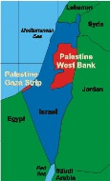

Slide 75
U.N. Security Council Resolution 242, Nov. 22, 1967
Calls for the withdrawal of Israeli forces from territories occupied in the war that year and “the acknowledgment of the sovereignty, territorial integrity and political independence of every state in the area and their right to live in peace within secure and recognized boundaries free from threats or acts of force.”
Notes:
4th Geneva Convention: Article 49. Individual or mass forcible transfers, as well as deportations of protected persons from occupied territory to the territory of the Occupying Power or to that of any other country, occupied or not, are prohibited, regardless of their motive.
Nevertheless, the Occupying Power may undertake total or partial evacuation of a given area if the security of the population or imperative military reasons so demand. Such evacuations may not involve the displacement of protected persons outside the bounds of the occupied territory except when for material reasons it is impossible to avoid such displacement. Persons thus evacuated shall be transferred back to their homes as soon as hostilities in the area in question have ceased.
The Occupying Power undertaking such transfers or evacuations shall ensure, to the greatest practicable extent, that proper accommodation is provided to receive the protected persons, that the removals are effected in satisfactory conditions of hygiene, health, safety and nutrition, and that members of the same family are not separated.
The Protecting Power shall be informed of any transfers and evacuations as soon as they have taken place.
The Occupying Power shall not detain protected persons in an area particularly exposed to the dangers of war unless the security of the population or imperative military reasons so demand.
The Occupying Power shall not deport or transfer parts of its own civilian population into the territory it occupies.

Slide 76
The Separation Wall
Notes:
In June 2002, the Israeli cabinet decided to erect a physical barrier separating Israel and the West Bank with the declared objective of regulating the entry of Palestinians from the West Bank into Israel. (http://www.btselem.org/separation_barrier)
Upon completion, the barrier's total length will be approximately 700 kilometres (430 mi). 90% of the length of this barrier is a fence with vehicle-barrier trenches surrounded by an on-average 60 metres (200 ft) wide exclusion area, and 10% of the barrier is an 8 metres (26 ft)-tall concrete wall.
According to the Israeli human rights organization B'Tselem, 8.5% of the West Bank area will after completion be on the Israeli side of the barrier, and 3.4% partly or completely surrounded on the eastern side.

Slide 80
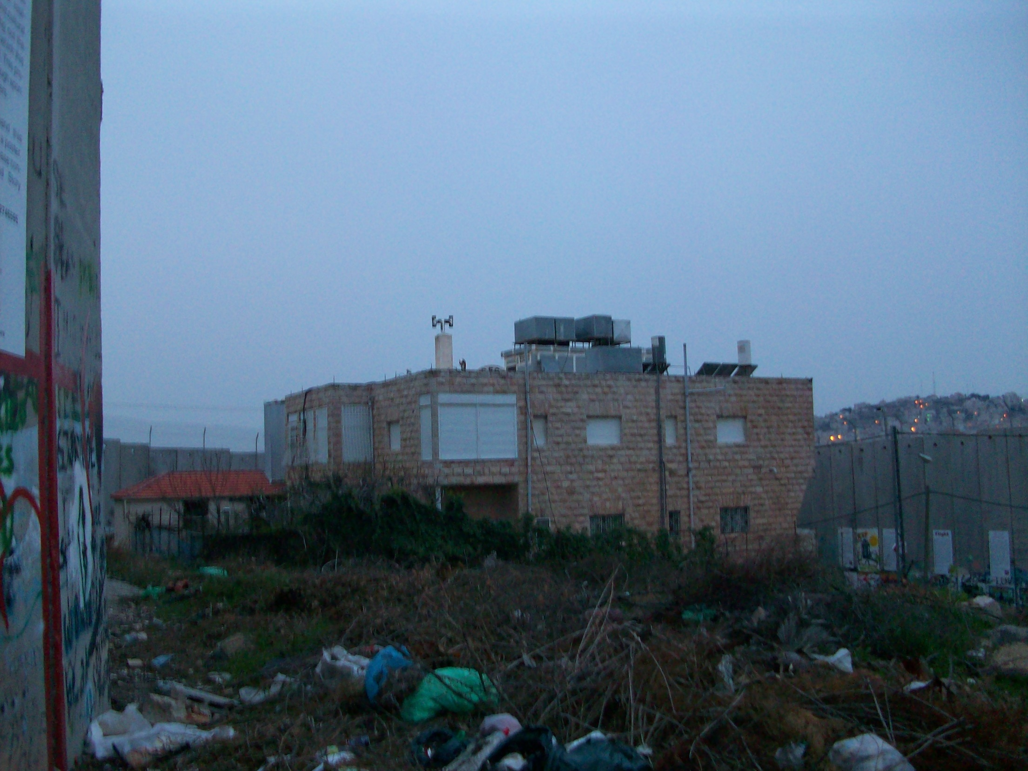

Slide 82
Settlements
* Since 1967 Israel has expropriated for settlements, highways, bypass roads, military installations, nature preserves and infrastructure 24% of the West Bank 89 % of East Jerusalem, 25% of Gaza.
* Settlements take up only 1.6% of West Bank, but 42% is under the effective control of Israel’s local and regional councils or military.
* As of Jan. 2014 there are approx. 375,000 Israeli settlers in the West Bank.
Notes:
According to figures released by Israel’s interior ministry, the number of settlers living in the Israeli-occupied West Bank rose to 375,000 in January 2014, up from 360,000 at the same time the year before, AFP reported on Thursday.
On March 3, data released by Israel’s Central Bureau of Statistics showed that the Tel Aviv regime began work on 2,534 settlement units in the year 2013, compared to 1,133 in 2012. (http://www.presstv.ir/detail/2014/03/07/353627/israel-settler-population-grows-over-4/)
“…a key goal of the settlement enterprise has been to foreclose the establishment of a viable Palestinian state…by carving the occupied territories into dozens of enclaves surrounded, isolated and controlled by Israeli settlements, infrastructure and military.”
-Jeff Halper Israeli Committee Against House Demolitions

Slide 83
Continued expansion by
Israel during peace talks

Slide 84
Appropriation of
water by settlements
Notes:
West Bank Palestinians - 70 Liters per day
Israelis & Settlers – 300 Liters per day
World Health Organization recommendation – 100 liters per day
Palestinians have water rations…settlements have swimming pools!

Slide 85
Checkpoints

Slide 86
Notes:
Between 2000-2005 sixty-seven Palestinian mothers forced to give birth at checkpoints—thirty-six babies died! Ambulances aren’t allowed through. Many women choose to give birth at home.

Slide 87
U.N. Security Council Resolution 446 March 22, 1979
Settlements in the Palestinian and other Arab territories occupied since 1967 have no legal validity and constitute a serious obstruction to achieving a comprehensive, just and lasting peace in the Middle East.

Slide 88
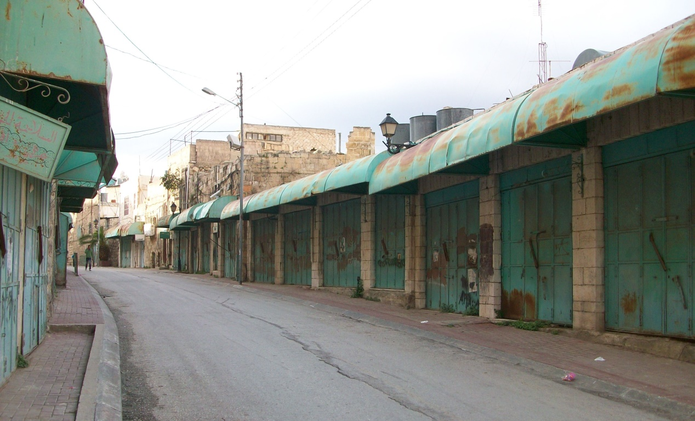
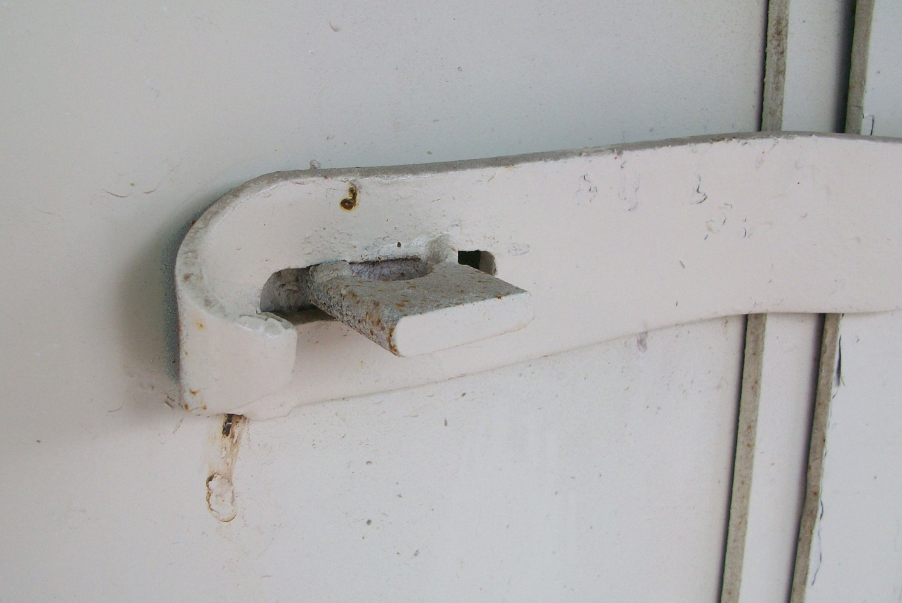
Shuhada Street Hebron
Settler Terrorism
Notes:
a shooting attack carried out by American-born Israeli Baruch Goldstein, a member of the far-right Israeli Kach movement, who opened fire on unarmed Palestinian Muslimspraying inside the Ibrahim Mosque (or Mosque of Abraham) at the Cave of the Patriarchs in Hebron, West Bank. It took place on February 25, 1994, during the overlapping religious holidays of Purim and Ramadan.^{[2][3]} The attack left 29 male worshippers dead and 125 wounded.^{[4]} The attack only ended after Goldstein had expended his ammunition, when he was overcome and beaten to death by survivors.
The attack set off riots and protests throughout the West Bank, and 19 Palestinians were killed by the Israeli Defense Forces within 48 hours of the massacre.^{[3]} Goldstein was widely denounced in Israel and by Jewish communities in the diaspora,^{[5]} with many attributing his act to insanity.^{[6]} Israeli Prime Minister Yitzhak Rabin condemned the attack, describing Goldstein as a "degenerate murderer", "a shame on Zionism and an embarrassment to Judaism".^{[7][8][9]} Some Jewish settlers in Hebron laud him as a hero and view his attack and subsequent death as an act of martyrdom.^{[10]}
In the weeks following the massacre, thousands of Israelis traveled to Goldstein's grave to celebrate Goldstein's actions. Some Hasidim danced and sang around his grave.^{[45]}Although the government has said that those who celebrated the massacre represented only a tiny minority of Israelis, a New York Times report states that Israeli government claims may understate the phenomenon.^{[45]}
In a pamphlet titled Baruch HaGever^{[Note 1]} published in 1994, and a book of the same name in 1995, various rabbis praised Goldstein's action as a pre-emptive strike in response to Hamas threats of a pogrom, and wrote that it is possible to view his act as following five Halachic principles.^{[46][47]}
The phenomenon of the adoration of Goldstein's tomb persisted for years, despite Israeli government efforts to crack down on those making pilgrimage to Goldstein's grave site.^{[48]} The grave's epitaph said that Goldstein "gave his life for the people of Israel, its Torah and land".^{[49]} In 1999, after the passing of Israeli legislation outlawing monuments to terrorists, the Israeli army acted to dismantle the shrine that had been built to Goldstein at the site of his interment.^{[49]} In the years after the dismantling of the shrine, radical Jewish settlers would celebrate Purim by invoking the memory of the massacre, sometimes even dressing up themselves or their children to look like Goldstein.
Two separate suicide bombings took place in March 1994, carried out by Palestinian militants inside Israel and launched by Hamas' Izzedine al-Qassam Brigades, in retaliation for the massacre carried out by Goldstein.^{[i][56]} A total of 15 Israeli civilians were killed and 34 wounded in the attack, which took place inAfula on April 6,^{[57]} at the end of the forty day mourning period for Goldstein's victims.^{[58]} Those were the first suicide bombings carried out by Palestinian fighters inside Israel. According to Matti Steinberg, who, at the time, was the Shin Bet head's advisor on Palestinian affairs, up until then Hamas had refused to attack civilian targets inside Israel, and the change in Hamas' policy was a result of Goldstein's massacre.
http://en.wikipedia.org/wiki/Cave_of_the_Patriarchs_massacre
Qibya massacreOctober 1953QibyaIDF troops under Ariel Sharon60–70Two thirds of the victims were women and children. Forty-five houses, a school, and a mosque were also destroyed.
Khan Yunis massacreNovember 3, 1956Khan Yunis, Gaza StripIDF 275 Israeli authorities and Palestinians gave differing accounts as to how the killings occurred
Rafah massacreNovember 12, 1956Rafah, Gaza StripIDF48-100 Refugees and local residents killed during massive screening operation after former Egyptian and Palestinian soldiers and Fedayeen hid among the local population.
Cave of the Patriarchs massacreFebruary 25, 1994HebronIsraeli Settler Baruch Goldstein2929 Muslims praying inside the Ibrahimi Mosque were killed with 125 more wounded.
Itamar attackMarch 11, 2011Itamar^{[9]}Two Palestinians^{[10]}5^{[11]}Both parents and three children of one family stabbed to death in their home, one infant decapitated.^{[12]}

Slide 92
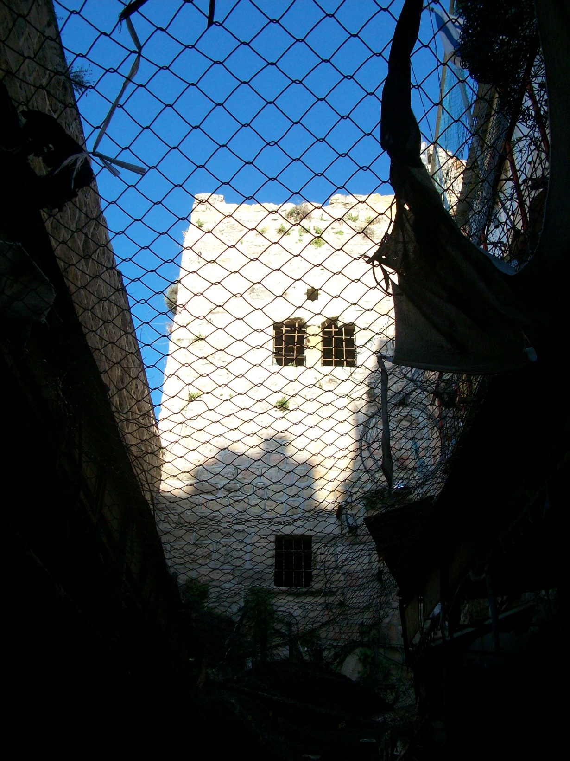

Slide 93
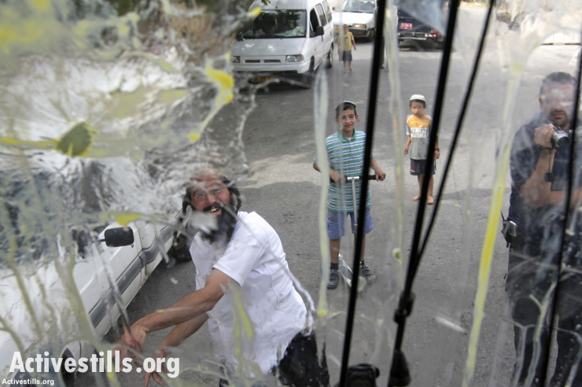
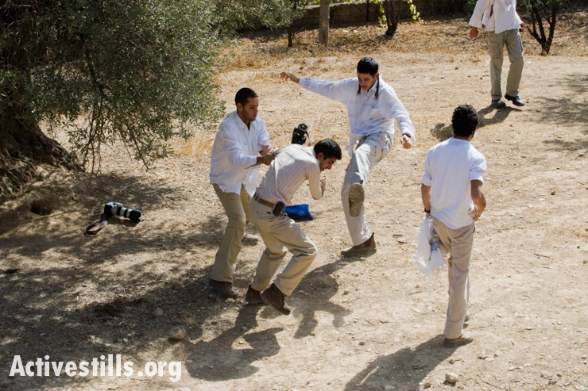

Slide 94
”The Six-Day War was forced upon us; however, the war’s seventh day, which began on June 12, 1967 and has continued to this day, is the product of our choice. We enthusiastically chose to become a colonial society, ignoring international treaties, expropriating lands, transferring settlers from Israel into occupied territories, engaging in theft and finding justification for all these activities. Passionately desiring to keep the occupied territories, we developed two judicial systems: one—progressive, liberal—in Israel and the other—cruel, injurious—in the occupied territories...

Slide 95
…In effect, we established an apartheid regime in the occupied territories immediately following their capture. That oppressive regime exists to this day. …the killing of little children fleeing for safety; the executions, without trial, of wanted persons who were not on their way to launch a terrorist act; and the encirclements, closures and roadblocks that have turned the lives of millions into a nightmare. Even if all these actions stem from our need to defend ourselves under an occupation’s conditions, the occupation’s non-existence would render them unnecessary.

Slide 96
…This is a harsh reality that is causing us to lose the moral base of our existence as a free, just society and to jeopardize Israel’s long-term survival. …An occupation regime undermines those principles of moral justice and prevents the attainment of peace. Thus, that regime endangers Israel’s existence.”
-Michael Ben-Yair, Former Supreme Court Acting Justice, Attorney General (Rabin, Peres, Netanyahu)
In Carey & Shainin, “The Other Israel: Voices of Refusal and Dissent” New York, The New Press. 13-15
Notes:
“If the Palestinians are to be held accountable for their terrorist actions, then Israel must be held accountable for policies and acts of state terrorism (for example, attacks on densely populated civilian centers with F-16s and Apache gunships, disproportionate violence against civilian populations, collective punishment, assassinations, and the indiscriminate use of snipers). Israel must also be held accountable for the structural violence inherent in its occupation (house demolitions, land exprorpriation settlements, destruction of agricultural land, monopolization of water supplies, impoverishment through economic closure, induced emigration, and all the other expressions of the occupation).”
-Jeff Halper, 2002 Israeli Committee Against House Demolitions

Slide 97
“Terrorism is a terrible thing. But the fact remains that when a small nation is ruled by a larger power, terror is the only means at their disposal. This has always been true, and I fear this will always be the case. If we want to end terrorism, we must end the occupation and make peace.”
-Gen. Matti Peled
Miko, Peled, “The General’s Son”
Notes:
“I favor unconditional withdrawal from the territories—preferably in the context of an agreement, but not necessarily: What needs to be done, urgently, is to withdraw from the territories. And a true withdrawal, which gives the Palestinians territorial continuity in a Transjordan linked to Gaza, open to Egypt and Jordan. If they proclaim their own state, Israel should be the first to recognize it and to propose state-to-state negotiations, without conditions…to resolve all pending problems.”
-Ami Ayalon, 2002 Head of Shin-Bet (1996-2000)

Slide 98
“Shorn of the hysteria, and with exceptions, a lot of the opposition to Israel’s actions has little or nothing to do with it being a Jewish state. Had it been a Hindu or a Buddhist state, for example, the Palestinians would have been no less embittered if the state in question had dispossessed them and then proceeded to dispossess them further. And it would still have attracted the opprobrium of people around the world, plenty of Jews included, who held a commitment to basic justice and fairness and…

Slide 99
the right to self-determination - the very attributes that, at an earlier point in time, underpinned widespread sympathy for a Jewish state.”
-Dr Tony Klug, 2009 Special advisor on the Middle East, Oxford Research Group

Slide 101
“We say the Palestinians behave like ‘madmen’; it is not madness but a bottomless despair.”
-Ami Ayalon, 2002 Head of Shin-Bet (1996-2000)
Notes:
“We have been generous and they refused!” is ridiculous, and everything that follows from this misperception is skewed.
Anyone who equals Arafat with bin Laden understands neither Arafat nor bin Laden.
[Ami Ayalon, Head of Shin-Bet from 1996-2000 (in “The Other Israel” 198)]

Slide 102
“Apartheid” State?
“The Jewish state is thus an enterprise in which the Arabs are not equal partners, in which their interests are placed below those of a different national group – most of whose members are newcomers to the land, and many of whom are not even living in the country.”
-Jdg. Ruth Gavison, 2003, Association for Civil Rights in Israel
Notes:
“In Israel, ‘“nationality” (Hebrew: ‘le’um’) and “citizenship” (Hebrew: “ezrahut”) are two separate, distinct statuses, conveying different rights and responsibilities’.
Non-Jews, can be citizens, but never nationals, and are thus denied ‘rights and privileges’ enjoyed by those ‘who would qualify for Israeli citizenship under the 1950 Law of Return’.”
- Ben White

Slide 104
Israeli school budgets
Jewish child per year:
$1,100
Palestinian child per year: $191
West Bank settler student:
$1,535.
Study in association with the Israeli Central Bureau of Statistics (White, p. 71).

Slide 105
Mainstream Institutional Prejudice
Palestinians in the city are a ‘strategic threat.’
-Nir Barkat, Mayor of Jerusalem
Palestinian citizens constitute the real ‘demographic problem’.
-Benjamin Netanyahu, 2003
‘it’s a matter of concern when the non-Jewish population rises a lot faster than the Jewish population.’
-Ehud Olmert, 1998

Slide 106
‘the Jews must stop burying their heads in the sand and recognize that the Arabs in Israel are our enemy.’
-Chair of the Knesset’s Ethics committee, 2010
“I see [it] as a national duty to prevent the spread of a population [the Arabs] that, to say the least, does not love the state of Israel ... If we go on like we have until now, we will lose the Galilee. Populations that should not mix are spreading there.”
-Ariel Atias, 2009, Housing Minister

Slide 107
“Bedouin are a bloodthirsty people who commit polygamy, have 30 children, and continue to expand their illegal settlements by taking over state lands. In their culture, they relieve themselves outdoors and don’t even know how to use the toilet.”
-Moshe Shohat, 2001 Head of the Educational Authority for Bedouins
“The delivery rooms in Soroka Hospital…have turned into a factory for the production of a backward population.”
-Dr Yitzhak Ravid, 2003 Armament Development Authority

Slide 108
“…there is one law for abandoned Arab property and another for abandoned Jewish property. This is unjust legislation.
Apartheid refers to segregation in the sense of one law for some people and another law for others. So if Muslims are not allowed to walk along a road and Jews are, then that’s truly Apartheid. There’s no way around it, and it’s a real pity that this situation was created.”
-Michael Ben-Yair
Former Attorney General
http://972mag.com/former-israeli-ag-we-should-have-evicted-hebron-settlers/88859/

Slide 109
“When a stranger resides with you in your land, you shall not do him wrong. The stranger who resides with you shall be to you as the native among you, and you shall love him as yourself; for you were aliens in the land of Egypt: I am the LORD your God.”
-Leviticus 19:33-34
"You are to have the same law for the alien and the native-born. I am the LORD your God."
-Leviticus 24:22
"The same laws and regulations will apply both to you and to the alien living among you."
-Numbers 15:16
Notes:
Israel’s government is no more based on Torah than the U.S. Constitution is based on the Sermon on the Mount.

Slide 110
Should followers of Jesus “stand with” any
political state?

Slide 112
ALL modern political states are a mixed bag.
ALL modern political states are earthly powers.
Jesus specifically said that His Kingdom (that is, the Kingdom of God!) was not of this world.
Jesus did not “stand with” Israel’s leadership anymore so than he did with Rome’s.
Jesus knew that being Abraham’s “seed” was a matter of devotion to God and covenant faith, not ethnicity or earthly citizenship.

Slide 113
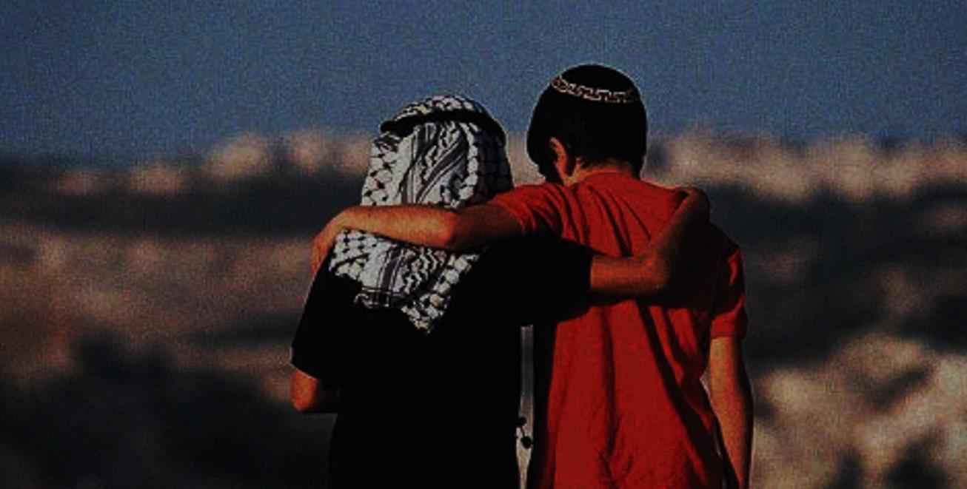
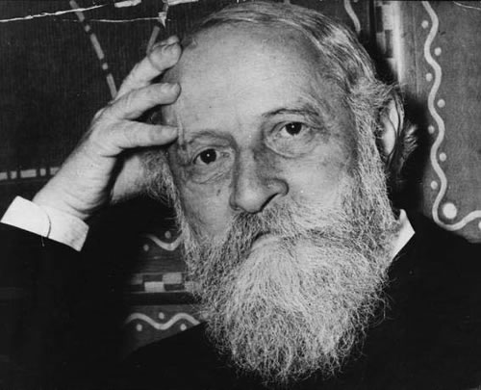
“...together with [the Arabs] we want to cultivate the land—to “serve” it as the Hebrew has it. The more fertile this soil becomes, the more space there will be for us and for them.”
-Martin Buber Letter to Gandhi, 1939

Slide 114
“Jesus is the owner of this land…not the two peoples who say God has no Son. The land is not exclusive. It is to be shared.”
-Daniel Juster Christ at the Checkpoint 2014

Slide 115
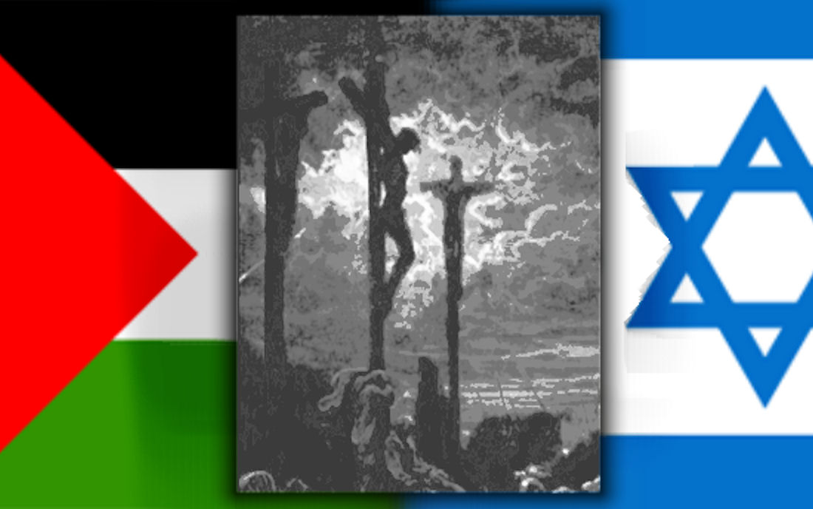
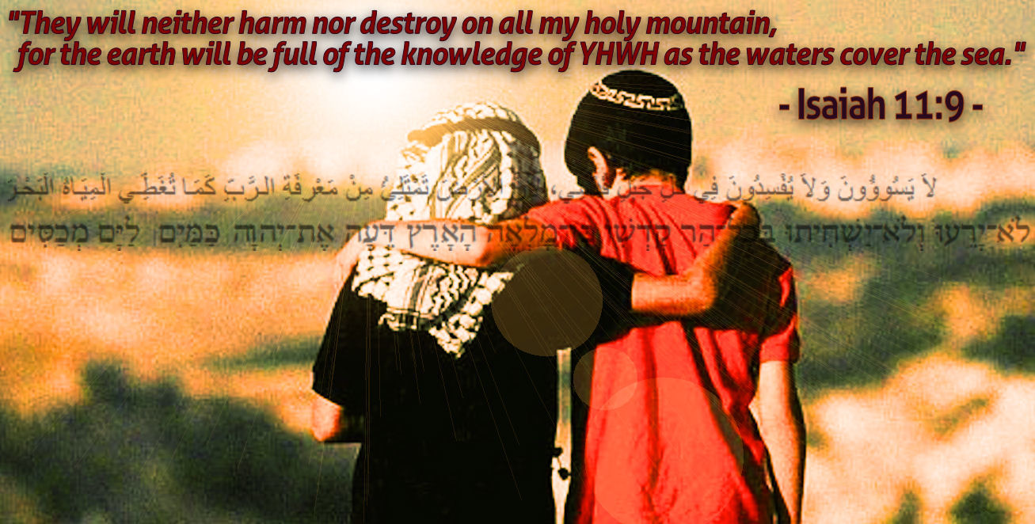
“Therefore, as we have opportunity, let us do good to all people, especially to those who belong to the family of believers.”
-Galatians 6:10

